Slide 1


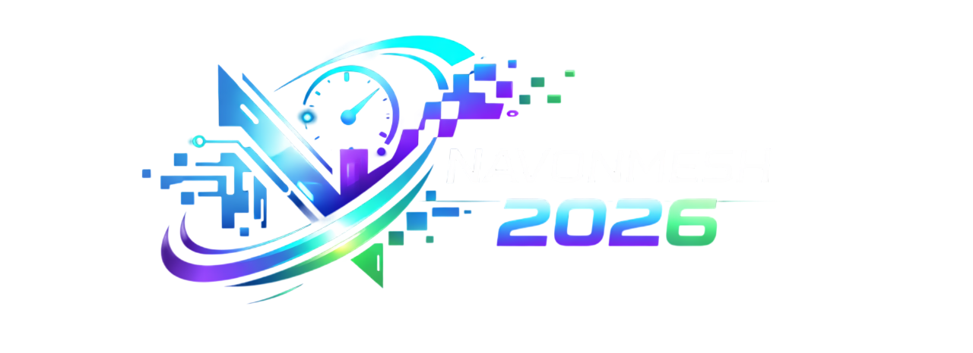
Maharashtra Education Society’s
Institute of Management and Career Courses (IMCC), Pune
Presents
Where Ideas Become Reality
Team Name :The CHAOS PRTOCOL
Team Lead Name: Pranjal Suryawanshi
Selected Domain :FINANCIAL SAFETY

Slide 2

THE CHAOS PROTOCOL
Problem Statement
Core Problem: Rural and elderly users are losing life savings to social engineering (fake KYC/Refund calls) because current security alerts are passive and text-heavy.
Target Demographic: 1. Non-tech-savvy elderly users.
2. Rural populations with low digital literacy
Gap in Existing Solutions: Current UPI apps only show English/Hindi text warnings that users "skip" or "dismiss" under pressure from scammers.
Urgency: Scam success rates are high during "Screen Sharing" (AnyDesk/TeamViewer), where users are manipulated into entering UPI PINs.
@Navonmesh 2026 Template - Institute of Management and Career Courses (IMCC), Pune

Slide 3
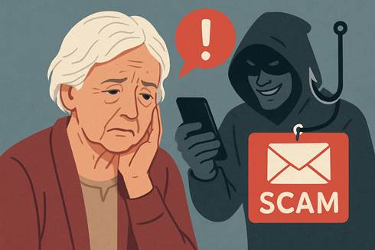
THE CHAOS PROTOCOL
IDEA TITLE
The "Active Guardian": A background Android Accessibility Service that acts as a proactive digital bodyguard.
Context-Aware Intervention: It doesn’t just warn; it intervenes by detecting:Active remote-access apps during a transaction.High-risk keywords (KYC, Refund, Block) in ongoing calls.
Interactive Voice Challenge: Automatically locks the payment UI and starts a voice-bot dialogue in the user's native language.
Informed Consent: The user must verbally confirm: "I am not
on a call with a stranger" to unlock the screen.
@Navonmesh 2026 Template - Institute of Management and Career Courses (IMCC), Pune

Slide 4
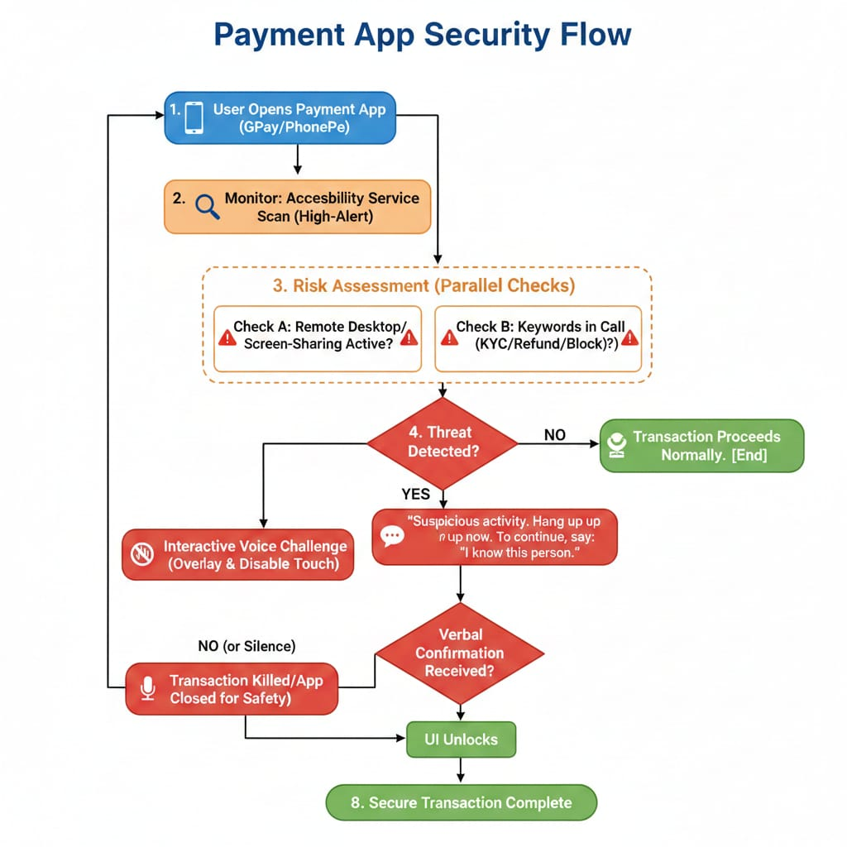
THE CHAOS PROTOCOL
TECHNICAL APPROACH
Tech Stack:
Language: Kotlin/Java (Android Accessibility Service API).NLP: On-device keyword spotting (TensorFlow Lite).
Voice: Google Text-to-Speech (TTS) & Speech-to-Text (STT) for native languages.
Methodology:
Layer 1: Monitor Accessibility Events to detect UPI app launch (Gpay / PhonePe).
Layer 2: Trigger context-check for is Screen Sharing
flag and call log keywords.
Layer 3: If risk detected, inject a System Alert Window.verlay to block user input.
@Navonmesh 2026 Template - Institute of Management and Career Courses (IMCC), Pune

Slide 5
The CHAOS PROTOCOL
FEASIBILITY AND VIABILITY
. Feasibility: Uses standard Android APIs. Can be integrated as a standalone "Security App" or a library for banking apps.
Challenges: Battery drain from background monitoring.
False positives during legitimate support calls.
Strategies: * Trigger-Based Activation: The service only "wakes up" high-intensity scanning when a payment app enters the foreground.
Privacy: All voice processing happens on-device; no data leaves the phone.
Q1`
@Navonmesh 2026 Template - Institute of Management and Career Courses (IMCC), Pune

Slide 6
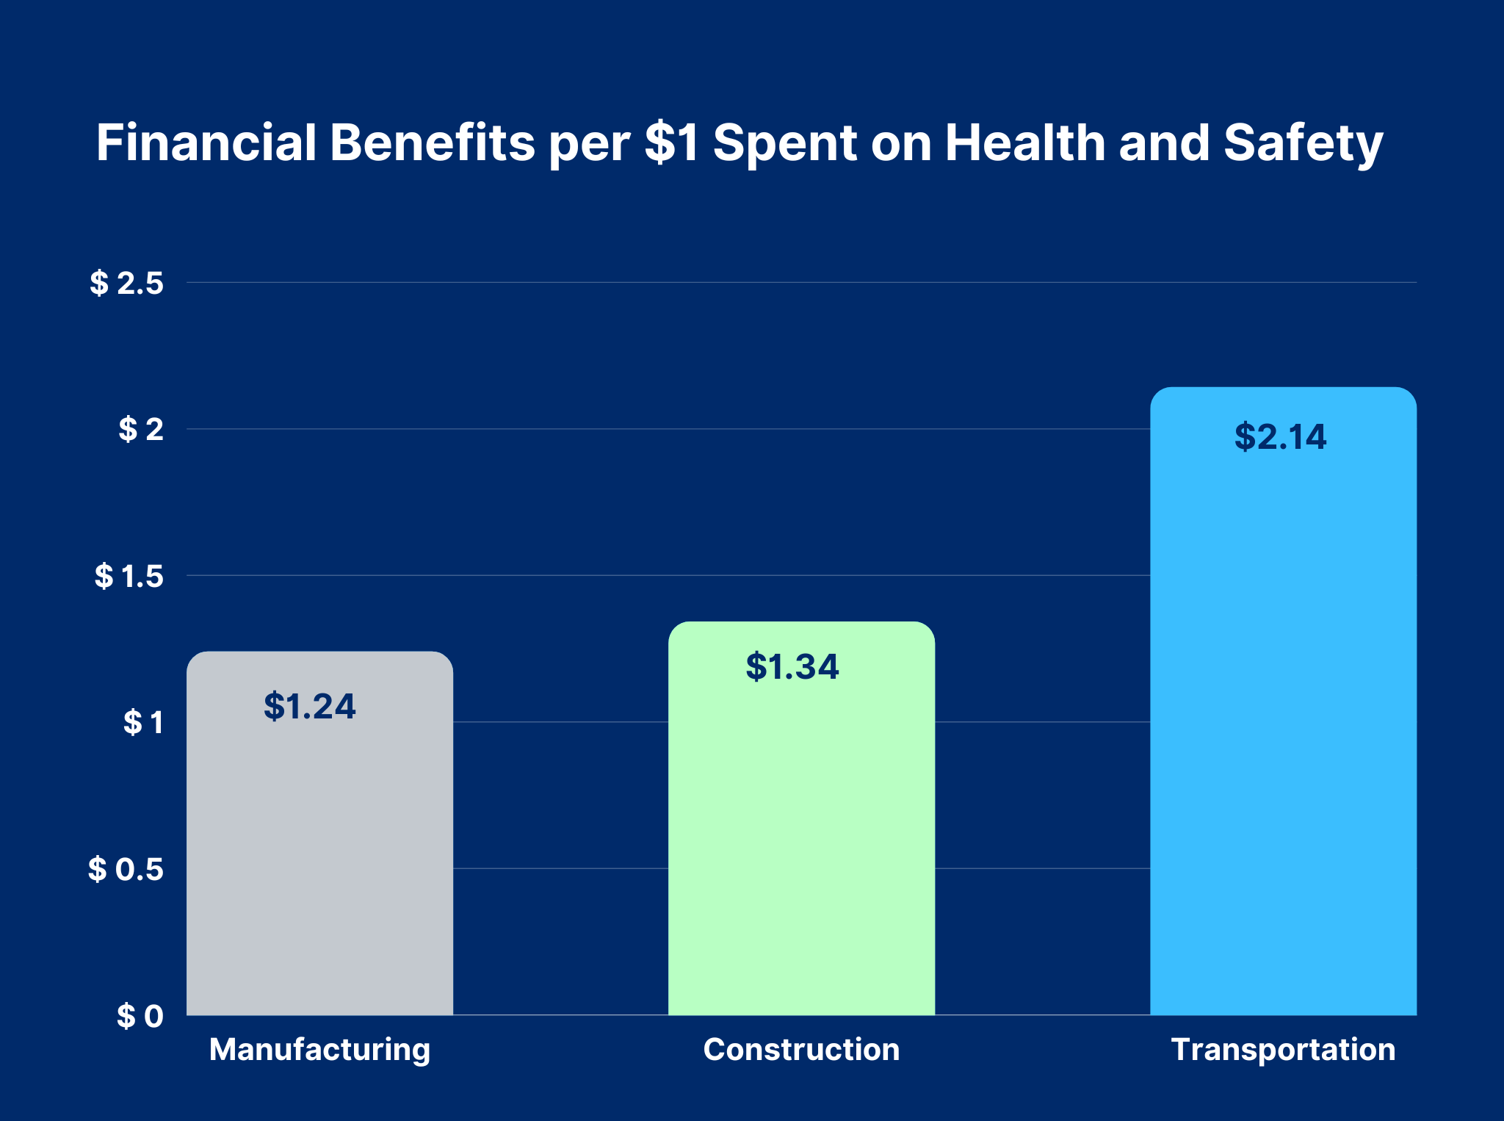
THE CHAOS PROTOCOL
IMPACT AND BENEFITS
Target Audience Impact: Moves the burden of security from the user’s knowledge to the system’s intelligence.
Social Benefit: Financial inclusion and safety for the "Bottom of the Pyramid" (rural users).
Economic Benefit: Significant reduction in UPI fraud losses, which currently account for crores in annual theft.
Environmental Benefit: Paperless,
digital-first security education via audio interaction.
@Navonmesh 2026 Template - Institute of Management and Career Courses (IMCC), Pune

Slide 7
THE CHAOS PROTOCOL
RESEARCH AND REFERENCES
Research Paper: "Social Engineering Attacks on UPI Users in India" - analyzed for keyword identification.
Documentation: Android Developer Guides for AccessibilityService and WindowOverlay.
Data Source: National Cyber Crime Reporting Portal (NCRB) statistics on elderly financial abuse.
Technical Reference: Google’s ML Kit for on-device Translation and NLP.
Thank you for your time.
Let's make UPI safer for everyone
@Navonmesh 2026 Template - Institute of Management and Career Courses (IMCC), Pune

